Slide 1
CHIP DESIGN FOR TURBO ENCODER MODULE FOR IN VEHICLE SYSTEM
GUIDENCE UNDER:
PROF. PRADOSH RANJAN SAHOO
PRESENTING BY:
PAVAN TOLUSURI-20BEV7048
RENUKA TELAGATHOTI -20BEV7042
SAI NAGESWAR VELPURI – 20BES7057

Slide 2
ABSTRACT
This paper studies design and implementation of the Turbo encoder to be an embedded
module in the in-vehicle system (IVS) chip.
Both serial and parallel computations for the encoding technique are studied. The two
design methods are presented and analyzed.
Developing the parallel computation method using carry increment adder, it is shown that both chip size and processing time are improved.
The logic utilization is enhanced by reduced area. The Turbo encoder module is
designed, simulated, and synthesized using Xilinx tools.
Xilinx vertex low power is employed. The Turbo encoder module is designed to be a
part of the IVS chip on a single programmable device.

Slide 3
INTRODUCTION
The European emergency call (eCall) system is a telematics system designed to save more lives in vehicle accidents. It is a governmental mandatory system that is to be implemented by March 2018.
The EU eCall system provides an immediate voice and data channel between the vehicles and an emergency center after car accidents.
The data channel provides the emergency center with the necessary data for emergency aids.
The EU eCall system main parts includes the in-vehicle system (IVS), the public safety answering point (PSAP), a cellular communication channel. The IVS activates the data channel automatically when a car accident occurs.

Slide 4
The European emergency call (eCall) system is a telematics system designed to save more lives in vehicle accidents. It is a governmental mandatory system that is to be implemented by March 2018.
The EU eCall system provides an immediate voice and data channel between the vehicles and an emergency center after car accidents.
The data channel provides the emergency center with the necessary data for emergency aids.
The EU eCall system main parts includes the in-vehicle system (IVS), the public safety answering point (PSAP), a cellular communication channel. The IVS activates the data channel automatically when a car accident occurs.

Slide 5
It discusses serial and parallel computation techniques for the Turbo encoder. It does not only design and implement the Turbo encoder module, but also proposes a better solution for the turbo encoder implementation.
The improvement of the chip size and processing time are exhibited by developing the parallel computation technique for the Turbo encoder.

Slide 7
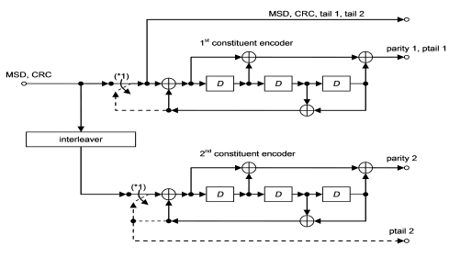
TURBO ENCODER BLOCK DIAGRAM

Slide 8
The turbo encoder technique is one of the most powerful FEC techniques in digital communication. The IVS employs a Turbo encoder module with 1=3 code rate.
The Turbo encoder functionalities are detailed in the third generation partnership project (3GPP) standards. The 3GPP Turbo encoder is illustrated in Figure 2.
The input signal of the turbo encodes is the MSD data appended with the CRC parity bits in binary. The block length of the MSD data is 1148 bits.
The output of the module is the MSD encoded data in binary. Implementing the turbo coding technique with 1=3 coding rate and thrills bits, the length of the output is 3456 bits. The thrills structure has an impact of the Turbo encoder.

Slide 9
The Turbo encoder employs a parallel concatenated convolution code (PCCC). The PCCC uses two constituent encoders with eight states as it is shown in Figure 2.
The initial status of the register are zeros. The first constituent takes the MSD bits and implements the employed convolution technique.
It takes one bit at a time and generates one bit of parity1 bits. The second constituent implements an identical technique of the first constituent, but it calls for the MSD bit after they are interleaved with a 3GPP designed interleaver technique.
The length of the input data, parity1, and parity2 are 1148 bits. There are 12 bits of the tail bits. They are driven from the shift register feedback. The tail bits are applied for end points between the encoded data blocks.
The output structure of the Turbo encoder is illustrated in Figure 3.

Slide 10


Slide 11
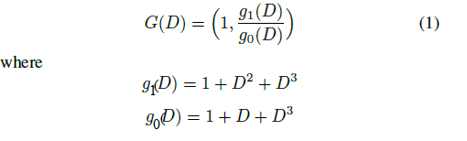
Interleaver

Slide 12
DESIGN FOR THE TURBO ENCODER MODULE
The technologies are employed to develop and implement the designed Turbo encoder module. The register transfer level (RTL) of the module is developed in Verilog HDL.
There are multiple registers defined for the input, output, and necessary parameters to implement the Turbo encoding technique. This work studies two methods to execute the encoding, which are serial computation and parallel computation.
The serial computation method processes one bit in one clock cycle. It reads the input data of the MSD, builds the input and output registers, and calculates the parity1, parity2, and the tail bits in a serial process.
After performing the encoding, it generates the output bits.

Slide 13
The parallel computing technique is employed to develop the Turbo encoder in Verilog.
There are many processes in the serial computation technique that are overlapped by using parallel computing technique.
There are two functions developed in the parallel Turbo encoder. The two functions implements almost all the processing time of the encoding technique.
The Turbo encoding technique needs the MSD data as a whole package to implement the encoding.

Slide 14
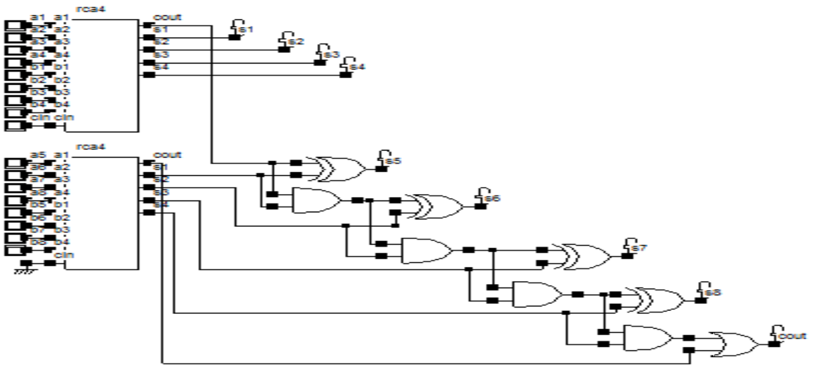
CARRY INCREMENT ADDER FOR DESIGN

Slide 15
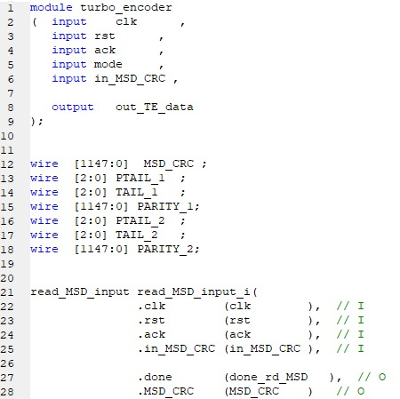
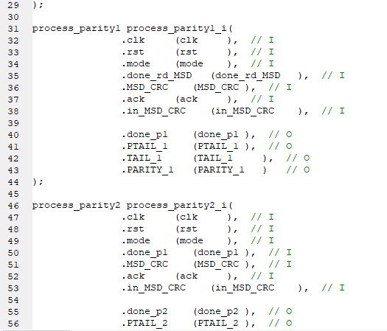
TOP MODULE CODE

Slide 16
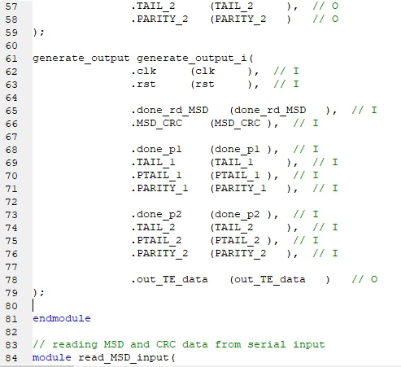
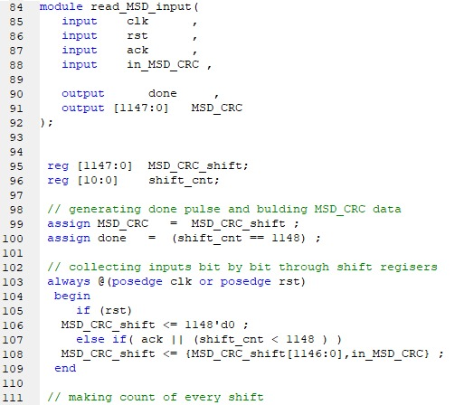
TOP MODULE CODE

Slide 17
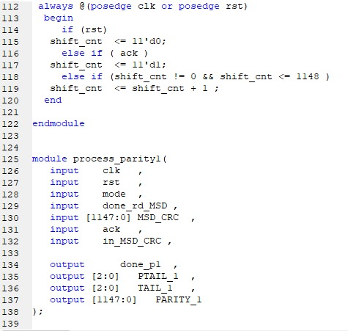
TOP MODULE CODE

Slide 18
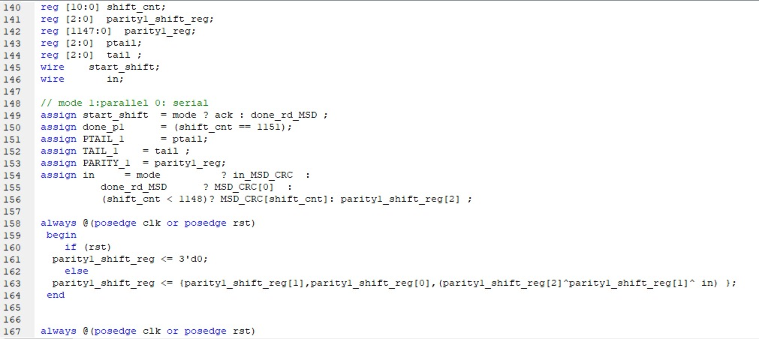
TOP MODULE CODE

Slide 19
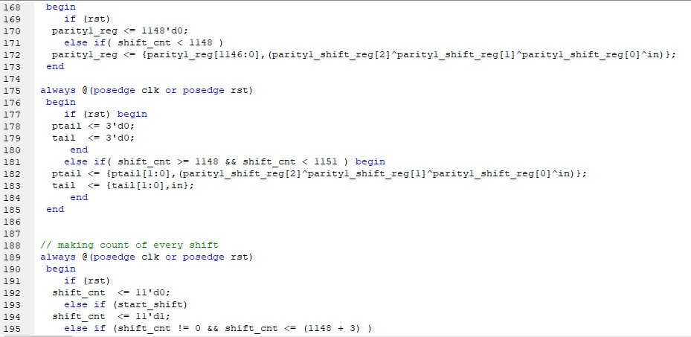
TOP MODULE CODE

Slide 20
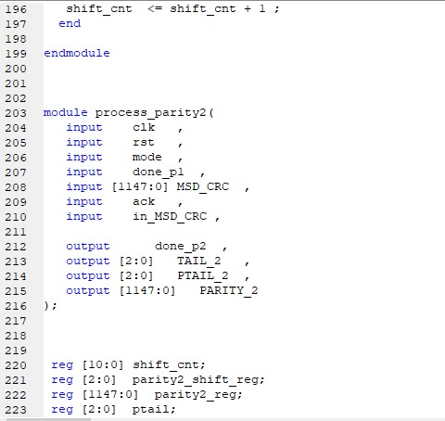
TOP MODULE CODE

Slide 21
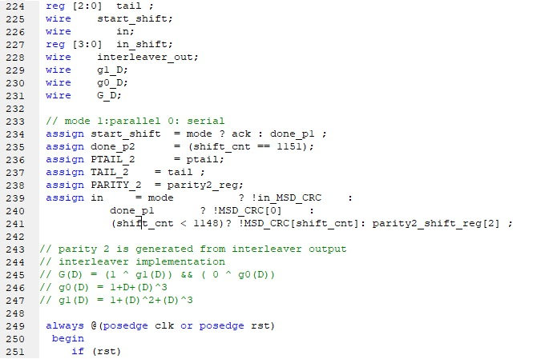
TOP MODULE CODE

Slide 22
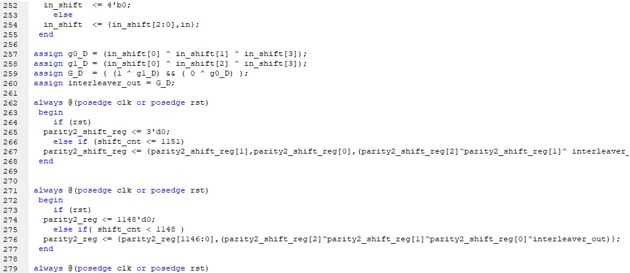
TOP MODULE CODE

Slide 23
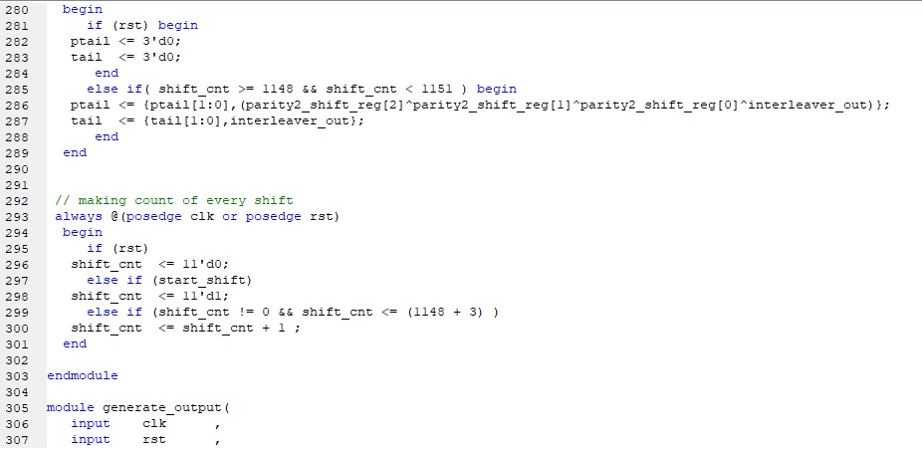
TOP MODULE CODE

Slide 24
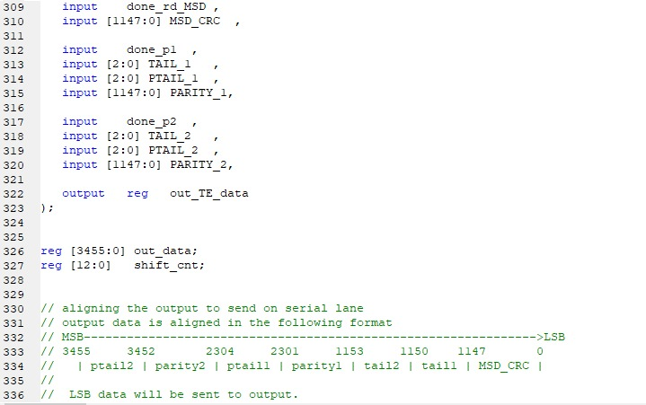
TOP MODULE CODE

Slide 25
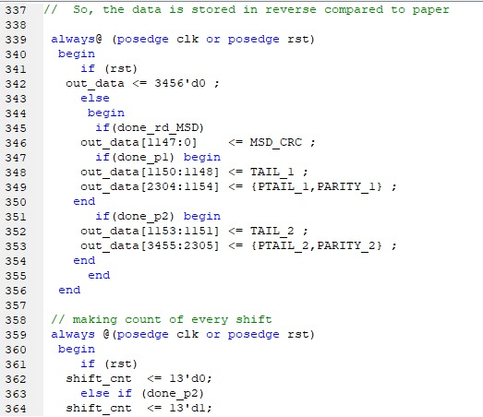
TOP MODULE CODE

Slide 26
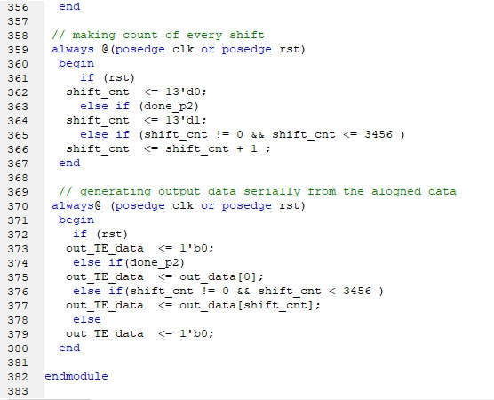
TOP MODULE CODE

Slide 27
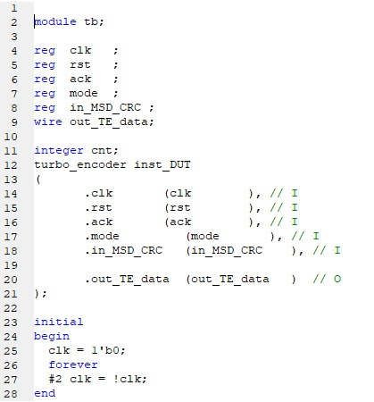
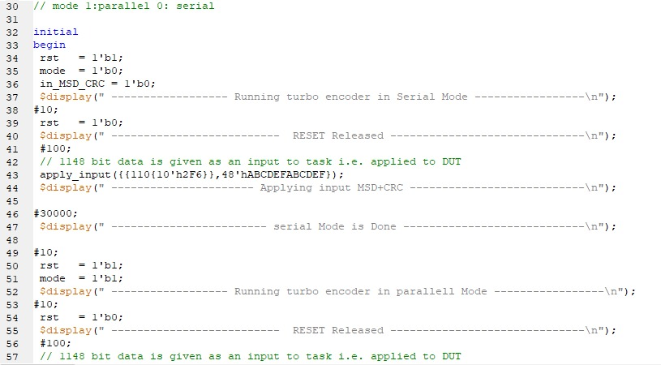
TEST BENCH CODE

Slide 28
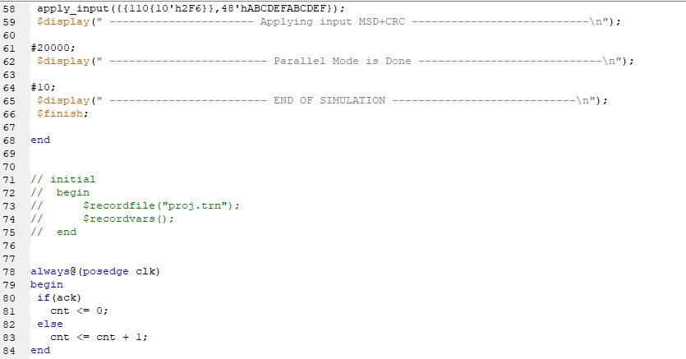
TEST BENCH CODE

Slide 29
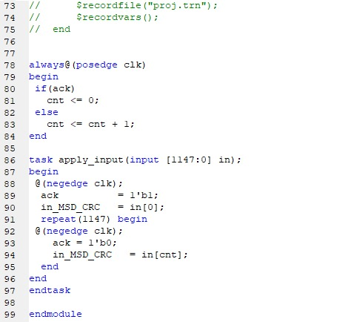
TEST BENCH CODE

Slide 30
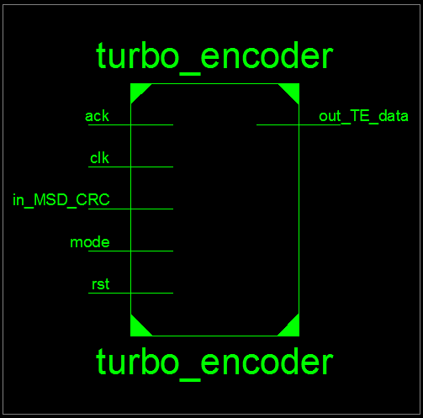
RESULTS:

Slide 31


Slide 32
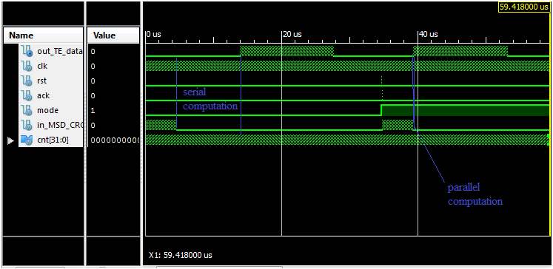

Slide 33
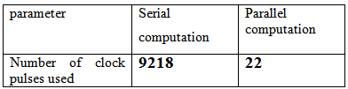

Slide 34
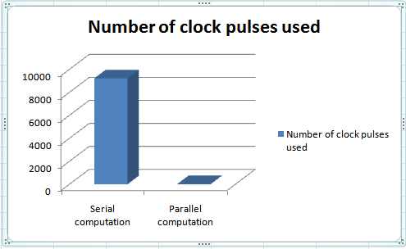

Slide 35
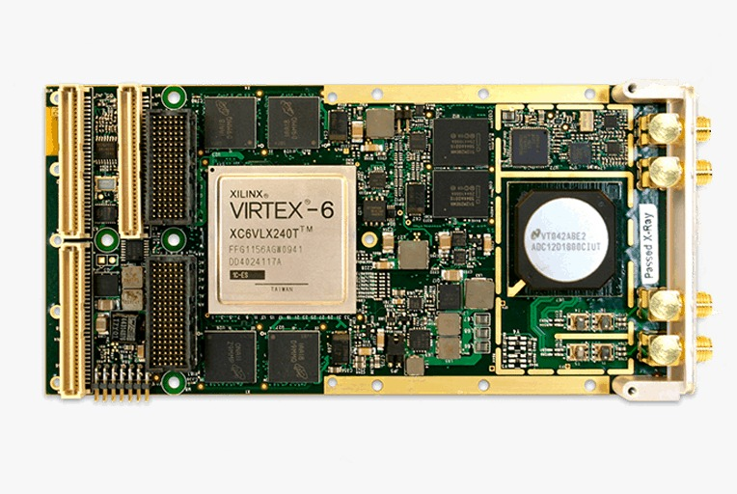
VIRTEX-6 FPGAs

Slide 36
Virtex-6 FPGAs help you to minimize design risk with integrated PCIe® interface blocks, DSP and other capabilities for building next-generation graphics, storage, networking, and system products. You can accelerate development with complete serial solutions for chip-to-chip, board-to-board, and box-to-box applications, while SelectIO™ technology and pre-verified IP cores make it easy to support all popular interface standards.

Slide 37
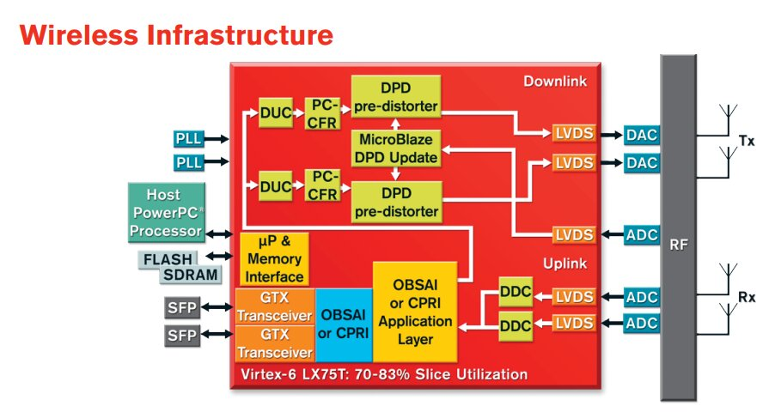
Wireless Infrastructure
Virtex-6 FPGAs help you to reduce cost and power consumption, deliver scalable platforms, and support multiple air interface standards. • Integrate crest factor reduction (CFR) and digital pre-distortion (DPD) algorithms to increase power amplifier efficiency up to 45% for reduced OPEX • Reduce power consumption by over 50% compared to ASSP-based implementation by integrating radio function into a single FPGA with the optimal balance of logic, memory, and DSP resources • Deliver flexible, multi-mode base stations that simplify the carriers’ challenge of supporting multiple air interfaces • Accelerate implementation with reusable IP for DUC/DDC, CFR, DPD, OBSAI, and CPRI

Slide 38
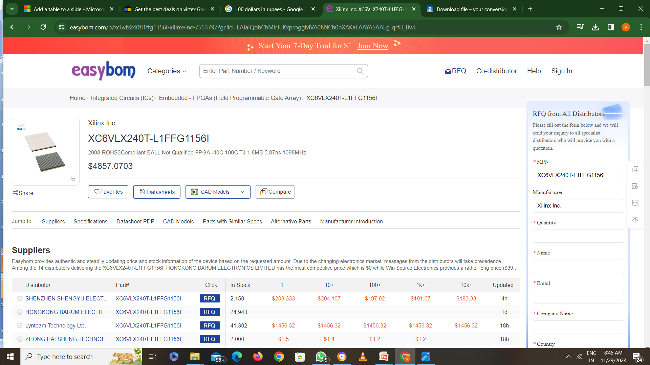
VIRTEX-6 CHIP XC6VLX240T-L1FFG1156I

Slide 39
CONCLUSION
The Turbo encoder module using carry increment adder is designed and implemented to be an embedded module in the IVS modem.
Xilinx tools and Verilog HDL are employed to design and simulate the module. Both serial and parallel computation techniques are studied for the encoding process.
It is shown that the parallel computation can improve the chip size and processing time of the module.
Comparing with the serial computation technique, the parallel computation encoding, using only 22 clock pulses and it improves the processing time by and logic utilization by 9218 clock pulses.
Additionally the proposed structure reduced area and power also. The processing time enhancement can be seen in both simulation and analyzing the chip processing.

Slide 40
FUTURESCOPE
Turbo encoders are error-correcting codes with performance close to the Shannon theoretical limit [SHA]. The encoder is formed by the parallel concatenation of two convolution codes separated by an interleaver or permuter.
In this project, I modeled and implemented a turbo encoder using magnitude comparator scheme using serial and parallel computing algorithm.
The advantage of turbo codes over existing coding schemes is that it attains a very low BER at low signal-to-noise ratios, so it will be used in used in communications . This makes it suitable for wireless applications where low transmission power is desired. However, the performance of turbo encodes on Rayleigh and Ricean fading channels remain an active subject of research.
The portability of this code to Advanced Design System (ADS) would be very beneficial for code re-usability and also the synthesis capability of ADS would result in faster product development.

Slide 41
THANK YOU

